Slide 1
API Styles

Slide 2

REST API
Notes:
So what is .NET?

Slide 3

gRPC

Slide 4
// The greeter service definition.
service Greeter {
// Sends a greeting
rpc SayHello (HelloRequest) returns (HelloReply) {}
}
// The request message containing the user's name.
message HelloRequest {
string name = 1;
}
// The response message containing the greetings
message HelloReply {
string message = 1;
}

Slide 5
Example .NET
syntax = "proto3";
option csharp_namespace = "GrpcExampleService";
package johoot;
// The greeting service definition.
service QuizeDefinition {
rpc SayHello (HelloRequest) returns (HelloReply);
rpc GetQuizeByID (QuizeIdMessage) returns (QuizeMessage);
rpc CreateQuize (QuizeMessage) returns (QuizeIdMessage);
}
// The request message containing the user's name.
message HelloRequest {
string name = 1;
}
message QuizeIdMessage{
int64 id = 1;
}
message QuizeMessage{
int64 id =1;
string name=2;
string description =3;
repeated QuestionMessage QuestionList =4;
}
message QuestionMessage{
int64 id = 1;
string text =2;
map<bool, string> answers = 3;
}
// The response message containing the greetings.
message HelloReply {
string message = 1;
}
syntax = "proto3";
option csharp_namespace = "GrpcExampleService";
package johoot;
// The greeting service definition.
service QuizeDefinition {
rpc SayHello (HelloRequest) returns (HelloReply);
rpc GetQuizeByID (QuizeIdMessage) returns (QuizeMessage);
rpc CreateQuize (QuizeMessage) returns (QuizeIdMessage);
}
// The request message containing the user's name.
message HelloRequest {
string name = 1;
}
message QuizeIdMessage{
int64 id = 1;
}
message QuizeMessage {
int64 id =1;
string name=2;
string description =3;
}
// The response message containing the greetings.
message HelloReply {
string message = 1;
}
Spacing matters
Many methods in one service
Simple types

Slide 6
ASP.NET Core configuration
public void ConfigureServices(IServiceCollection services)
{
services.AddGrpc();
}
public void Configure(IApplicationBuilder app, IWebHostEnvironment env)
{
if (env.IsDevelopment())
{
app.UseDeveloperExceptionPage();
}
app.UseRouting();
app.UseEndpoints(endpoints =>
{
endpoints.MapGrpcService<QuizeDefinitionService>();
endpoints.MapGet("/", async context =>
{
await context.Response.WriteAsync("Communication with gRPC endpoints
must be made through a gRPC client. To learn how to create a client,
visit: https://go.microsoft.com/fwlink/?linkid=2086909");
});
});
}

Slide 7
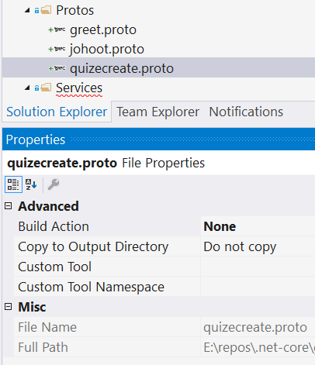
Add proto
Adding new file is not telling DotNet that it’s gRPC
https://docs.microsoft.com/en-us/aspnet/core/tutorials/grpc/grpc-start?view=aspnetcore-3.1&tabs=visual-studio

Slide 8
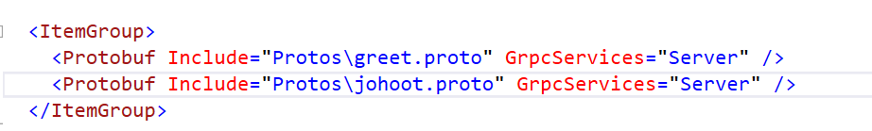
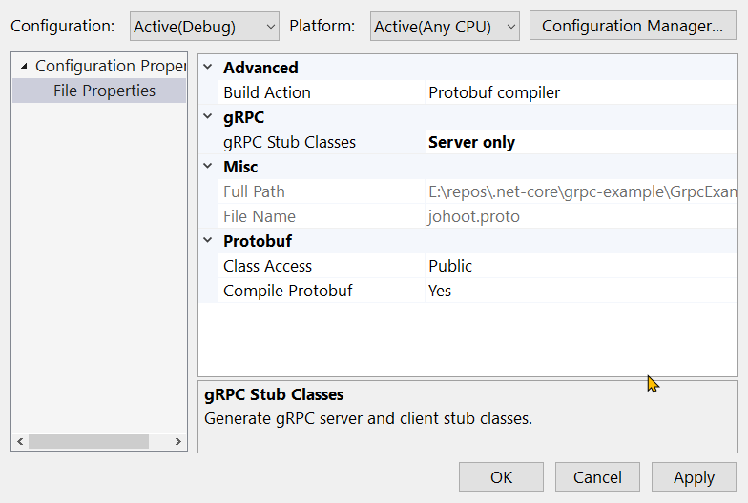
Introduce gRPC to generate classes

Slide 9
Other types
message QuizeMessage{
int64 id =1;
string name=2;
string description =3;
repeated QuestionMessage QuestionList =4;
}
message QuestionMessage{
int64 id = 1;
string text =2;
map<bool, string> answers = 3;
}
var result = new QuizeMessage
{
Id = 19,
Name = "Bla bla quize",
Description = "some more bla bla ",
QuestionList =
{
new QuestionMessage {
Id=21,
Text="question1"},
new QuestionMessage {
Id=23,
Text="question3",
Answers={
{true,"this is good" },
{ false, "this is not so good"}
}
},
}
};

Slide 10
List = stream
rpc GetQuizeList (QuizeIdMessage) returns (stream QuizeMessage);
public override async Task GetQuizeList(
QuizeIdMessage request,
IServerStreamWriter<QuizeMessage> responseStream,
ServerCallContext context)
{
var result = new List<QuizeMessage>() {new QuizeMessage{…}};
foreach (var item in result)
{
await responseStream.WriteAsync(item);
}
}

Slide 11
gRPC Client
Any app – eg. ConsollApp
Include *.proto files
Nugget
Install-Package Grpc.Net.Client
Install-Package Google.Protobuf
Install-Package Grpc.Tools

Slide 12
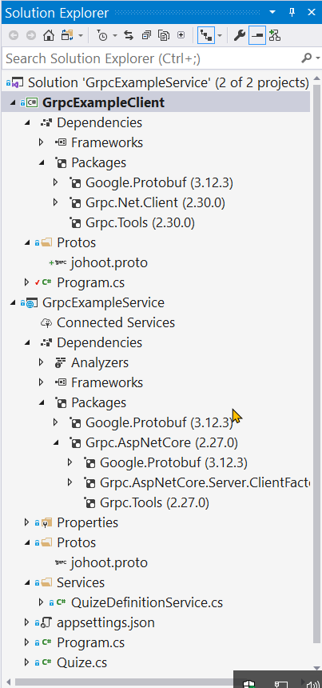
gRPC Client
Any app – eg. ConsollApp
Include *.proto files
Nugget
Install-Package Grpc.Net.Client
Install-Package Google.Protobuf
Install-Package Grpc.Tools

Slide 13
gRPC Client call service
class Program
{
static void Main(string[] args)
{
Console.WriteLine("Hello World!");
// The port number(5001) must match the port of the gRPC server.
var channel = GrpcChannel.ForAddress("https://localhost:5001");
var client = new QuizeDefinition.QuizeDefinitionClient(channel);
var request = new QuizeIdMessage { Id = 1 };
var reply = client.GetQuizeByID(request);
Console.WriteLine($"{reply.Id}, {reply.Name}, {reply.Description}");
Console.WriteLine("Press any key to exit...");
Console.ReadKey();
}
}
}

Slide 14
gRPC Client for stream
// The port number(5001) must match the port of the gRPC server.
var channel = GrpcChannel.ForAddress("https://localhost:5001");
var client = new QuizeDefinition.QuizeDefinitionClient(channel);
var request = new QuizeIdMessage { Id = 1 };
var quizeItems = new List<QuizeMessage>();
using (var call = client.GetQuizeList(request))
{
while (await call.ResponseStream.MoveNext())
{
var item = call.ResponseStream.Current;
quizeItems.Add(item);
Console.WriteLine($"{item.Id}, {item.Name}, {item.Description},
{item.QuestionList?.Count}");
}

Slide 15
Import
import "google/protobuf/timestamp.proto";
import "google/protobuf/empty.proto";
rpc DeleteQuize (QuizeIdMessage) returns (google.protobuf.Empty);
message Person
{
string name = 1;
int32 id = 2;
bool has_ponycopter = 3;
}
public override Task<Empty> DeleteQuize(
QuizeIdMessage request,
ServerCallContext context)
{
//…code to delete a customer…
return Task.FromResult(new Empty());
}
https://docs.microsoft.com/en-us/aspnet/core/tutorials/grpc/grpc-start?view=aspnetcore-3.1&tabs=visual-studio
Notes:
message SalesOrder { int32 SoId = 1; google.protobuf.Timestamp DeliveryDate = 2;
https://visualstudiomagazine.com/articles/2020/01/16/grpc-well-known-types.aspx
public override Task<Empty> DeleteQuize(QuizeIdMessage request, ServerCallContext context)
{
//…code to delete a customer…
return Task.FromResult(new Empty());
}

Slide 16

GraphQL

Slide 17
Setup steps
Install-Package GraphQL
Install-Package GraphQL.Server.Transports.AspNetCore
Install-Package GraphQL.Server.UI.Playground
Add middlewares
Create Schema
Resolve Query
Resolve Mutations

Slide 18
And then even more to define
Your graph entities
Every available query
Every mutation
Schema and mutations

Slide 19
Query Type definition
public class QuizeType : ObjectGraphType<Quize>
{
public QuizeType()
{
Field(t => t.Id);
Field(t => t.Name)
.Description("The name of the quize");
Field(t => t.Description);
}
}

Slide 20
Define Query Type
public class QuizeQuery : ObjectGraphType
{
public QuizeQuery(IQuizesRepository repository)
{
Field<ListGraphType<QuizeType>>(
"quizes",
resolve: context => repository.GetAll()
);
}
}

Slide 21
Define Query
public class JohootQuery : ObjectGraphType
{
public JohootQuery(IQuizesRepository repository)
{
Field<ListGraphType<QuizeType>>(
"quizes",
resolve: context => repository.GetAll()
);
Field<ListGraphType<QuestionType>>(
"questions",
resolve: context => repository.GetAll()
);
}
}

Slide 22
Mutation Type definition
public class ProductReviewInputType: InputObjectGraphType
{
public ProductReviewInputType()
{
Name = "reviewInput";
Field<NonNullGraphType<StringGraphType>>("title");
Field<StringGraphType>("review");
Field<NonNullGraphType<IntGraphType>>("productId");
}
}

Slide 23
Define Mutation
public class CarvedRockMutation : ObjectGraphType
{
public CarvedRockMutation(ProductReviewRepository reviewRepository)
{
FieldAsync<ProductReviewType>(
"createReview",
arguments: new QueryArguments(
new QueryArgument<NonNullGraphType<ProductReviewInputType>> {Name = "review"}),
resolve: async context =>
{
var review = context.GetArgument<ProductReview>("review");
return await context.TryAsyncResolve(
async c => await reviewRepository.AddReview(review));
});
}
}

Slide 24
Schema
public class WorkshopSchema : Schema //version 3
{
public WorkshopSchema(IServiceProvider provider) : base(provider)
{
Query = provider.GetService(typeof(JohootQuery)) as JohootQuery;
Mutation = provider.GetService(typeof (CarvedRockMutation)) as CarvedRockMutation;
}
}
public class CarvedRockSchema: Schema // version 2
{
public CarvedRockSchema(IDependencyResolver resolver): base(resolver)
{
Query = resolver.Resolve<CarvedRockQuery>();
Mutation = resolver.Resolve<CarvedRockMutation>();
}
}

Slide 25
Thanks! Questions?

